Slide 1
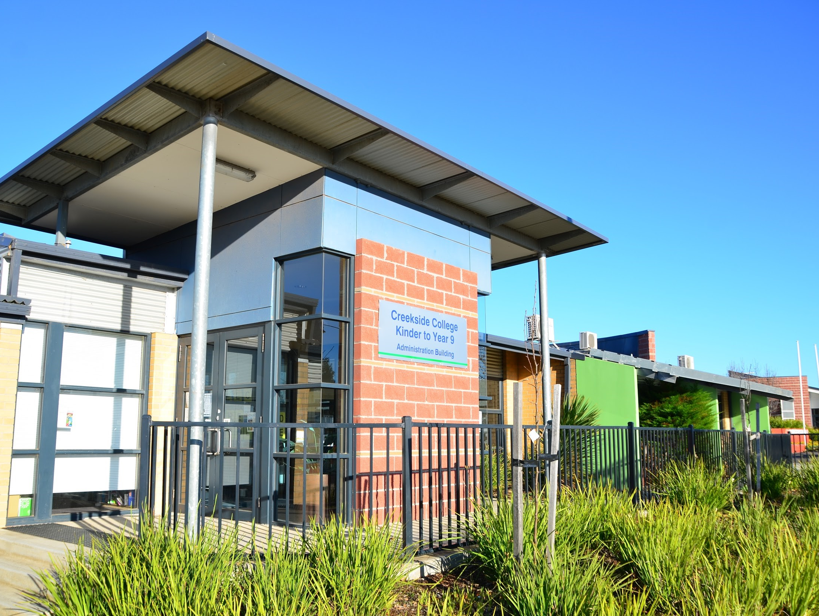

CREEKSIDE COLLEGE KINDER TO YEAR 9 “Learning for Life”
Prospective Family Information Night 2027
Notes:
Katia - Play Lake Dewar Camp video while people are entering https://www.youtube.com/watch?v=IY_xc6MSW4o

Slide 2
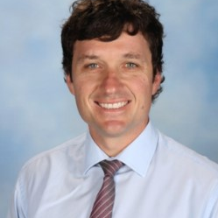
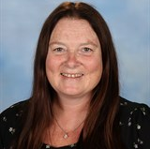
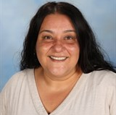
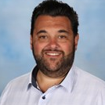
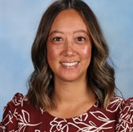
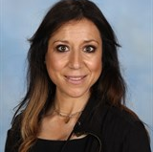
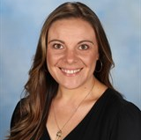
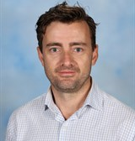
INTRODUCTION
Peter Dalinkiewicz
Principal
Michelle Lowry
K-2 Assistant Principal
Suzi Stojkov
3-6 Assistant Principal
Daniel Xuereb
P-9 Wellbeing Assistant Principal
Leeza Thompson
7-9 Assistant Principal
Katia Gerovasilis
Acting Assistant Principal
Caroline Curmi
7-9 Leading Teacher
Will Grbic
7-9 Leading Teacher
Notes:
Katia

Slide 3
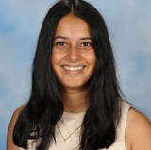
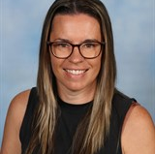
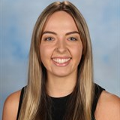
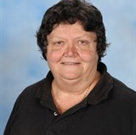
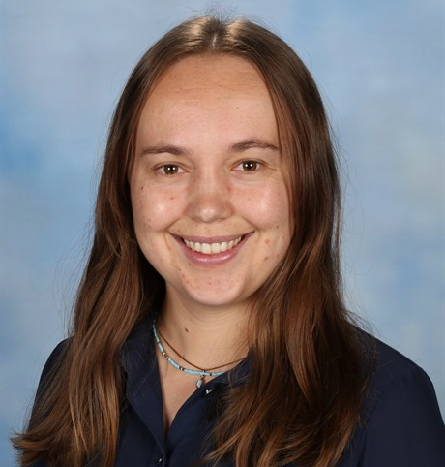
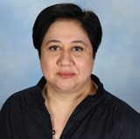
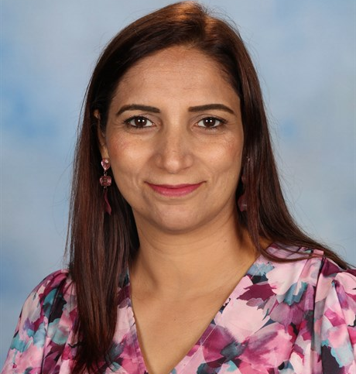
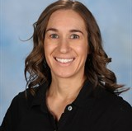
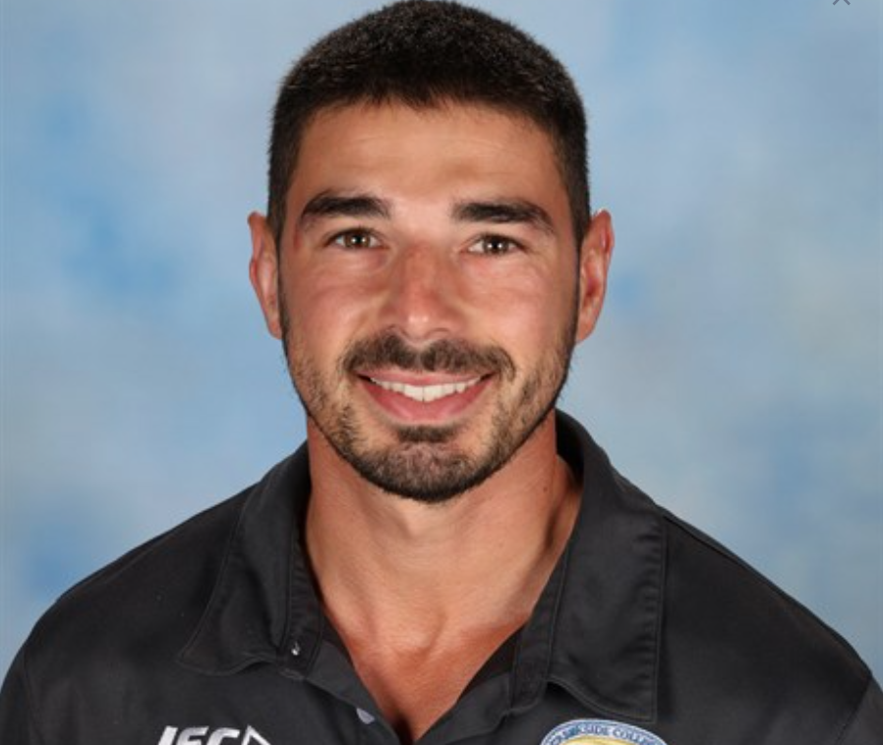
INTRODUCTION
Courtney Pereira
Learning Specialist
Jacqui Grant
Learning Specialist
Shannon Smith
Leading Teacher
Marg Keatley
Head of Wellbeing Team
Alisha Johnson
Year 7 Coordinator
Suzie Silveira
Year 8 Coordinator
Raman Sidhu
Year 8 Coordinator
Simone Smakman
Year 9 Coordinator
Jaycob Hickey
Year 9 Coordinator
Notes:
Katia

Slide 4
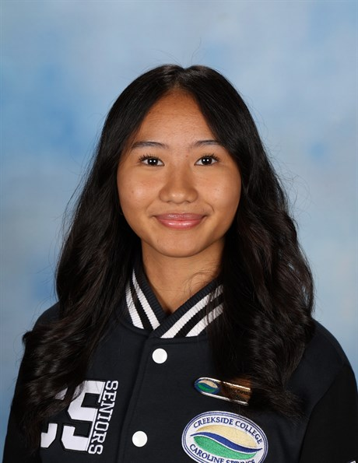
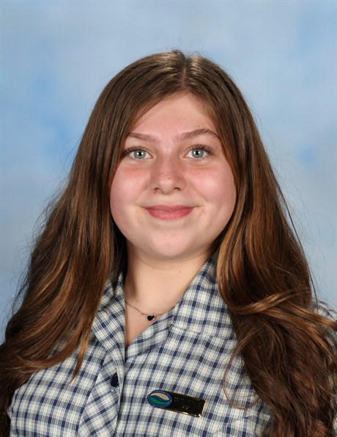
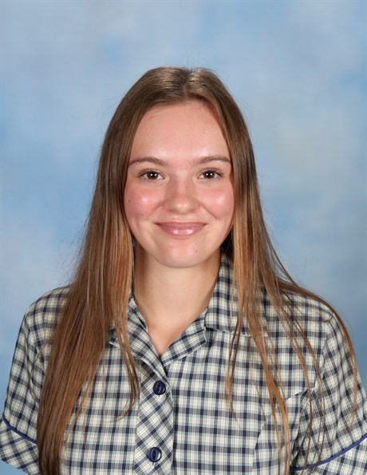
INTRODUCTION
Alyson Solomon
School Captain
Teah Frendo
School Captain
Alyssa Bajorek
School Captain
SRC captains
Notes:
Katia

Slide 5
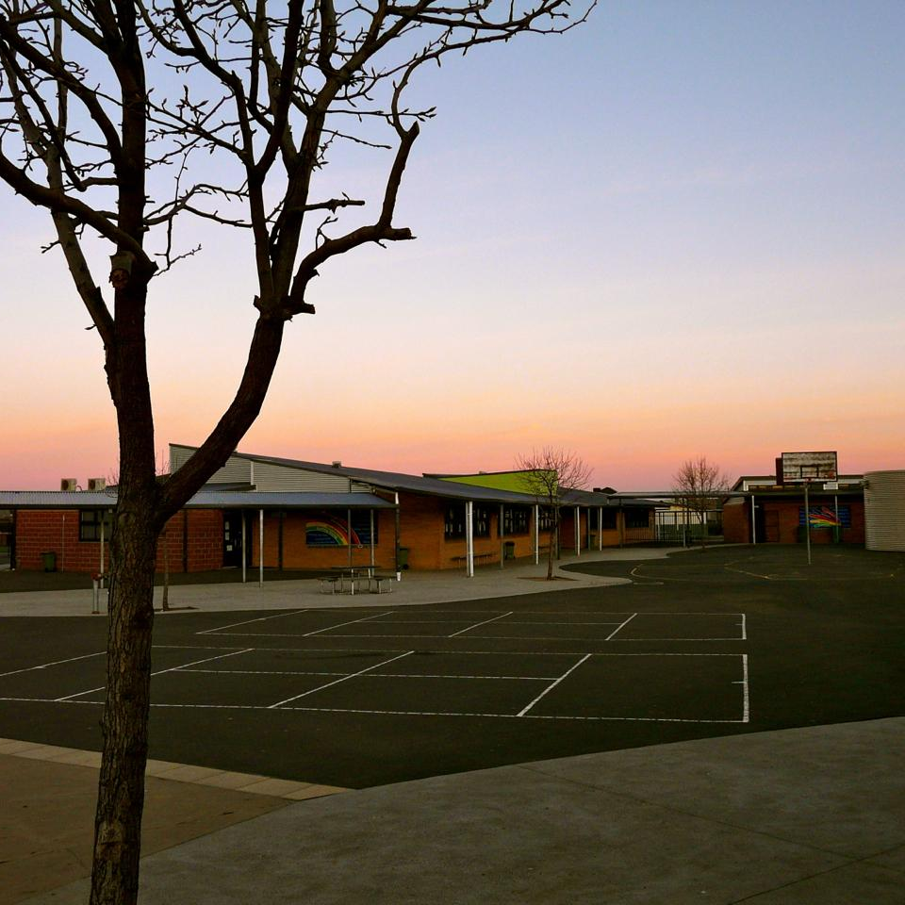

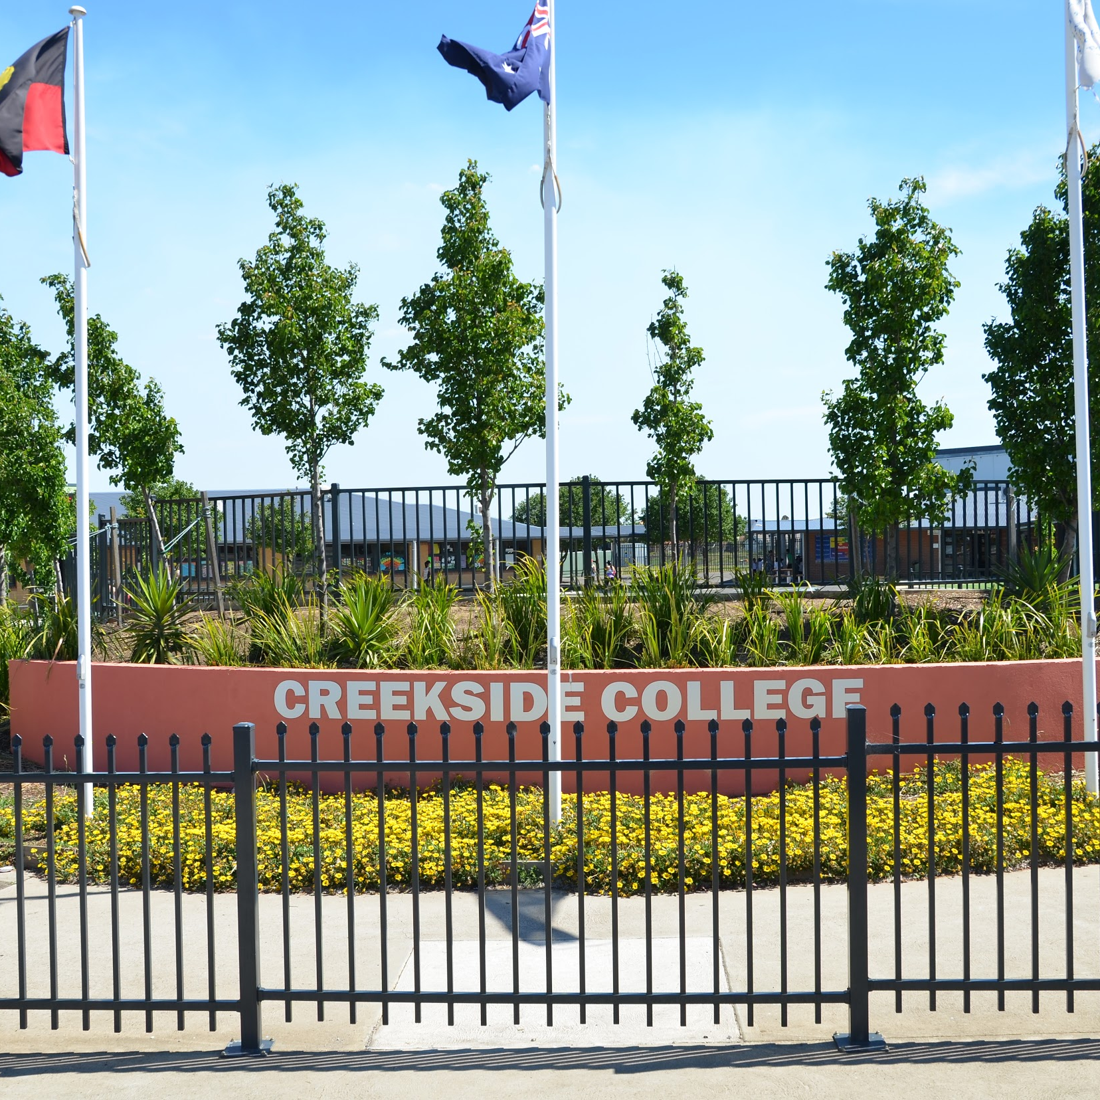
CREEKSIDE K-9 SCHOOL STRUCTURE
Creekside K-9 College currently has 1198 students enrolled, and has over 100 teaching staff. The college is divided into 3 sub-schools: K-2, 3-6 and 7-9, and runs on two timetables (P-6 and 7-9).
The college has one principal and four assistant principals as well as a number of curriculum and wellbeing leaders.
Notes:
Katia

Slide 6




OUR VISION AND VALUES
Creekside K – 9 College will instill the values and develop the skills and knowledge students need to live effective and purposeful lives in the global community.
Responsibility
Respect
Honesty
Acceptance
Notes:
Katia

Slide 7
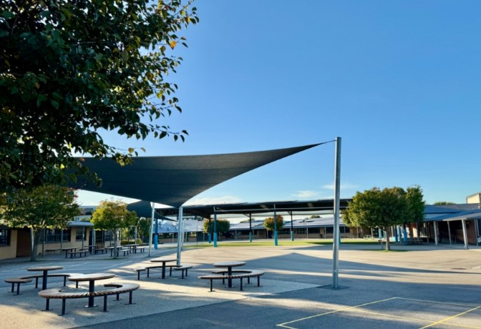
Why choose Creekside K-9 College for Year 7 in 2027?

Slide 8
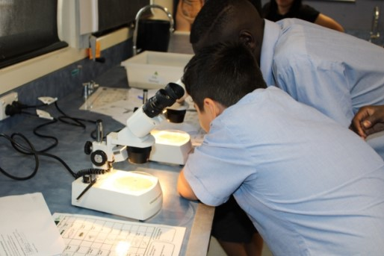
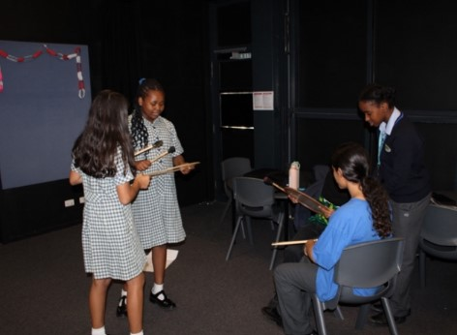
WHY CHOOSE CREEKSIDE COLLEGE?
A unique setting for junior high school students
An emphasis on student wellbeing.
Strive to have the best teachers in front of our students
Proven track record in improving student outcomes
Strong links with Lakeview Senior College
Notes:
Katia

Slide 9
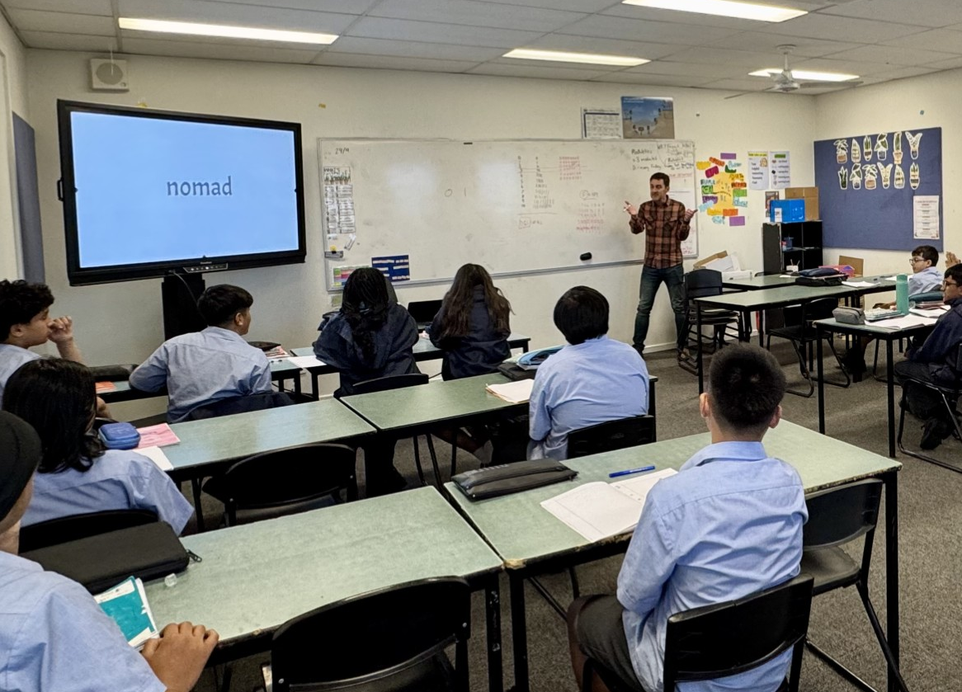
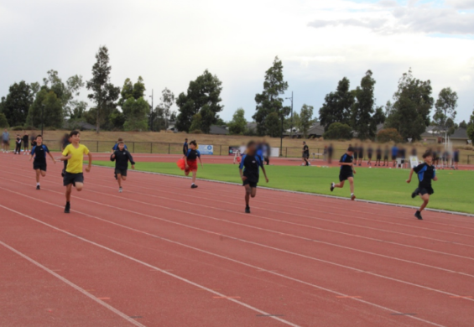
A UNIQUE SETTING FOR MIDDLE YEARS STUDENTS
Students feel part of a close-knit 7-9 sub school
Year 9 students are the seniors of the college
Leadership opportunities.
Comprehensive ‘Electives’ program
Access to a careers counsellor and careers education in Year 9
Notes:
Katia

Slide 10
EMPHASIS ON STUDENT WELLBEING
SUPPORT STAFF
Home Group Teachers
Year Level Coordinators
Leading Teachers
Wellbeing Team
PROGRAMS
Tutoring/RTI
Hands on Learning
Student Leadership
Respectful Relationships
SWPBS
Start Up Program
Year 7 Transition
Teacher Hand-Over
Step Up Program
Year 10 Transition
Careers
TRANSITION
THE STUDENT
Camps
Excursions
Interschool Sport
Lunch Time Clubs
Cross Country
Instrumental Lessons
Strong House Culture
Carnivals
Home Group Challenges
Attendance Procedures
Breakfast Club
EXTRA-CURRICULAR ACTIVITIES
ENGAGEMENT & CONNECTEDNESS
Notes:
Katia

Slide 11
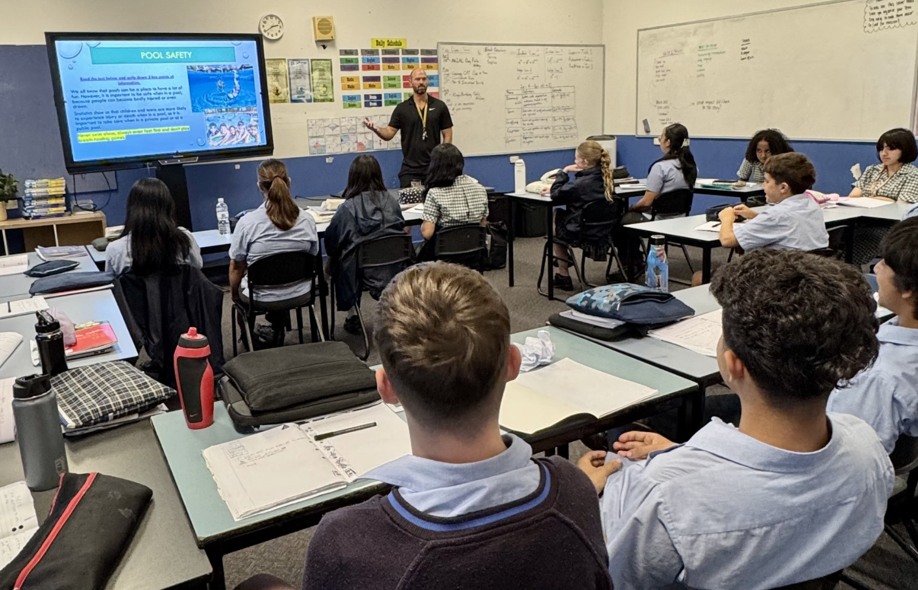
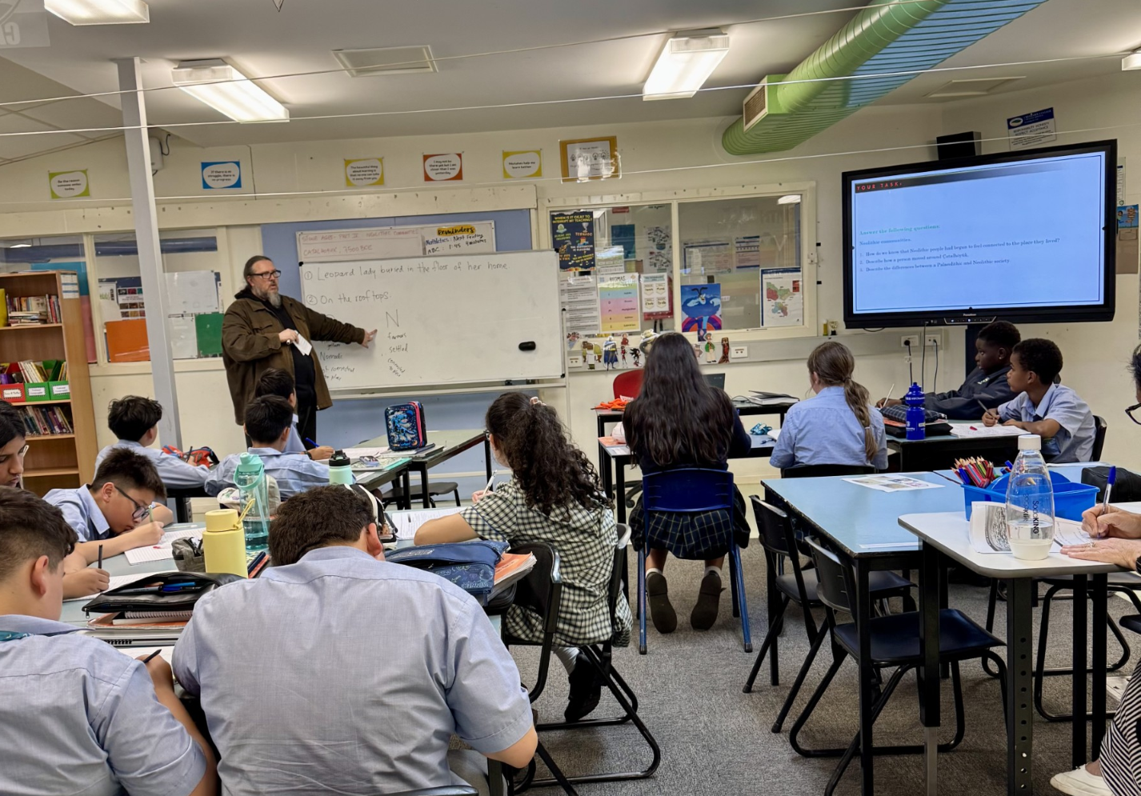
EXCELLENCE IN TEACHING
The school is focused on putting the best teacher in front of the classroom
Regular professional learning for all our teaching staff
Our teachers are able to teach to the point of need
The school intervenes and extends student learning through our RTI program
Notes:
Katia

Slide 12
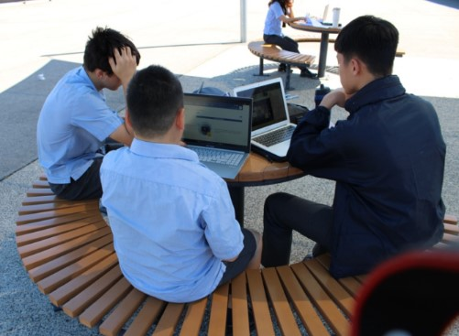
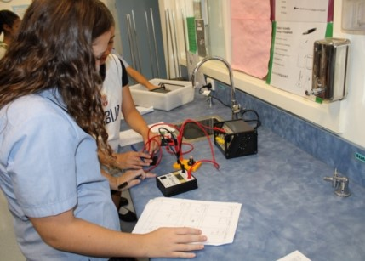
PROVEN TRACK RECORD
NAPLAN results have consistently been strong in both performance and growth measures. (My School website)
Results in literacy and numeracy are amongst the strongest in the Brimbank Melton network (across years 7 to 9)
We continue to grow students at their point of need, with many students achieving more than 12 months growth in a year
Creekside College has some of the highest attendance rates in the Brimbank Melton Network
Notes:
Katia - Change Red Text

Slide 13

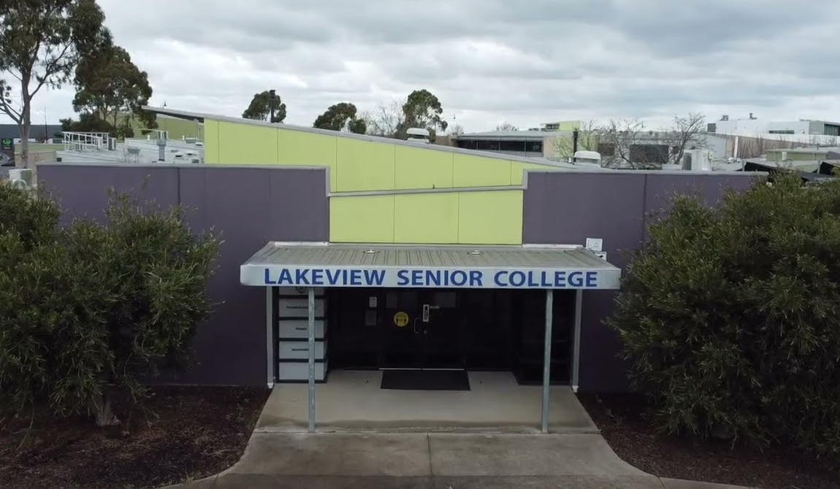
STRONG LINKS WITH LAKEVIEW SENIOR COLLEGE
95% of students from Creekside go on to attend LSC.
Curriculum leaders are in frequent contact with Lakeview to ensure we are best preparing them for years 10 to 12.
A comprehensive wellbeing and academic transition program.
In 2025, 40 students started VCE subjects in Year 10.
In 2025, the top 2 highest ATAR scores were received by ex-Creekside students.
Notes:
Katia - look to update with 2025 data

Slide 14
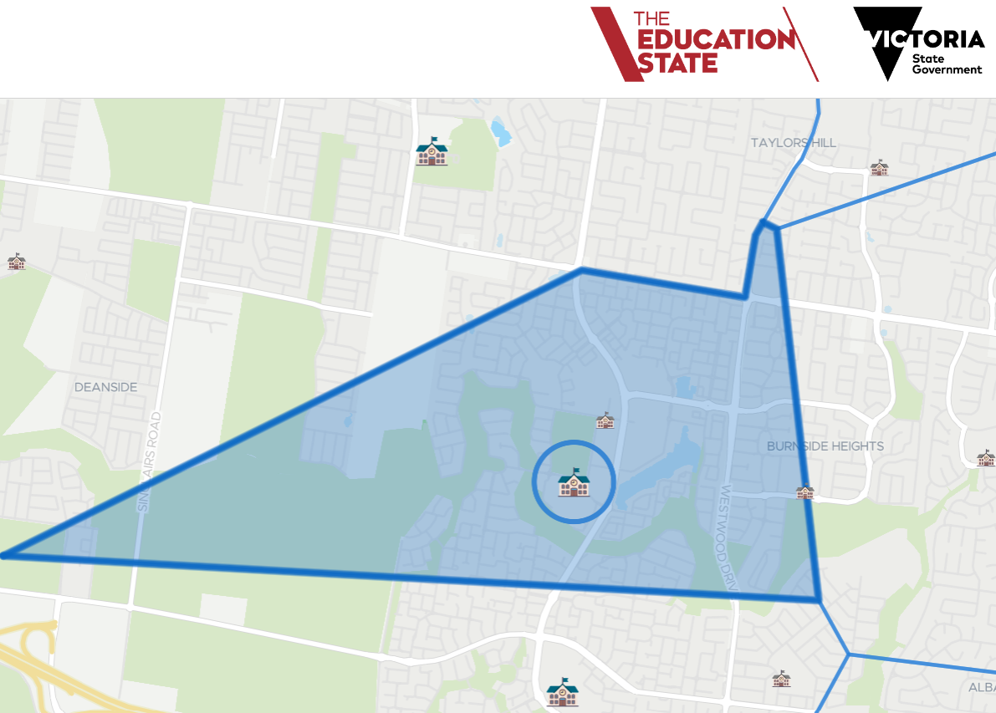
CREEKSIDE K-9 COLLEGE YEAR 7 ZONE 2027
https://www.findmyschool.vic.gov.au/
Notes:
Katia -

Slide 15
IMPORTANT DATES
Wednesday 22nd April - Government primary schools distribute the Transition Information Pack for parents/carers to all families of current Year 6 students.
Friday 8 May 2026 - Parents/carers return Application for Year 7 Placement 2026 forms to government primary schools by this date.
Wednesday 24th of June 2026 - Parents and carers are notified, in writing, by their child’s primary school of their 2027 offer.
Friday 17th July 2026 - Closing date for parents/carers to lodge a written non-placement appeal with their preferred secondary schools.
Tuesday 8th December 2026 - Secondary schools host an Orientation Day for Year 6 students.
Notes:
Katia - update dates for 2026

Slide 16



CREEKSIDE K-9 COLLEGE
Thank you for attending.
Please follow us on Instagram via the QR code below.
Now we will split into groups for a school tour and to hear from some of our staff and students!
Connect with us:
www.creeksidecollege.vic.edu.au
Notes:
Katia to break the group up for tours.

Slide 17
LEARNING AT CREEKSIDE
CURRICULUM
INSTRUCTION
STUDENT NEEDS & INTERESTS
ASSESSMENT
Notes:
Courtney

Slide 18
OUR CURRICULUM
RELEVANT AND MEANINGFUL
PROVIDES DEPTH & BREADTH
CHALLENGING FOR ALL
CORE SUBJECTS (All year long)
English
Mathematics
Science
Humanities
Health
Physical Education
French
SEMESTER-BASED SUBJECTS
Drama
Visual Communication & Design
Visual Art
Food Technology
Media
Notes:
Courtney

Slide 19
ENGLISH AT CREEKSIDE
Literacy skills are developed through a holistic approach, not taught in isolation.
READING
WRITING
SPEAKING & LISTENING
Notes:
Courtney

Slide 20
ENGLISH AT CREEKSIDE
Creekside College provides opportunities for extra support and extension in learning.
RESPONSE TO INTERVENTION (RTI)
VICTORIAN HIGH-ABILITY PROGRAM (VHAP)
STUDY CLUB
Notes:
Courtney

Slide 21




ENGLISH AT CREEKSIDE
YEAR 7
Term 1 - Persuasive Texts
Term 2 - Film as Text
Term 3 - Novel Study
Term 4 - Context Study
These units are shaped by what is taught at VCE. Skills progress throughout 7 to 9.
Notes:
Courtney

Slide 22



ENGLISH AT CREEKSIDE
YEAR 8
Term 1 - Persuasive Texts
Term 2 - Film as Text
Term 3 - Novel Study
Term 4 - Context Study
Notes:
Courtney

Slide 23



ENGLISH AT CREEKSIDE
YEAR 9
Term 1 - Persuasive Texts
Term 2 - Film as Text
Term 3 - Novel Study
Term 4 - Context Study
Notes:
Courtney

Slide 24




MATHEMATICS AT CREEKSIDE
BASED ON RESEARCH OF HOW CHILDREN LEARN
ASSESSMENT
HOMEWORK
SUPPORT
Notes:
Will
FOUNDED ON RESEARCH OF HOW CHILDREN LEARN: discussion, appropriate challenge, students given opportunities to experience the mathematics themselves with their ideas being used to then derive formal concepts, more responsibility on student to get the most of class
ASSESSMENT: regular pre-/post-testing, ongoing check-ins to monitor progress, semester exams (to experience and develop skills for success with high stakes exams in senior school)
HOMEWORK: no text, mathletics used at the moment. cater to each students’ needs, interactive and engaging, instant feedback for teachers
SUPPORT: MLYNS, High achievers, tutoring, RTI

Slide 25




ASSESSMENT
MEASURES GROWTH & ACHIEVEMENT
CELEBRATES AND SHARES SUCCESS
HELPS WITH PREPARATION FOR VCE
Feedback & Goal Setting
Assessment Tasks
Semester Exams
Reports
Notes:
Will

Slide 26
CURRICULUM
Hear from our student leaders!
YEAR 9
ELECTIVES
Literature
Visual art
Outdoor Education
Medical Science
Business Management
Legal Studies
Coding
Woodwork
Music
Australian Rules
Soccer Development
STEM
Forensic Science
Food Technology
Advanced Maths
Maths & The Real World
Notes:
Will
Preparing students for their career pathways
Taste of VCE
Breadth/Enrichment subjects
2 per semester
Some have additional cost
availability subject to change
AFL, Business management, history, medical science, outdoor education, psychology, visual communications, advanced sport, visual art, food tech, forensic science, legal studies, literature, maths in the real world, soccer

Slide 27
CURRICULUM
LAKEVIEW TRANSITION
Strong connections with Lakeview
Host series of student info sessions throughout Year 9
3 days of transition in December
Support students with subject selection, including applying for accelerated subjects
Notes:
Will
Strong connection with Lakeview
· Many curriculum choices are based off what students would experience at Lakeview, to prepare them for VCE
· Series of Lakeview information sessions run with students to help with subject selection
· Support students who want to have tours before the end of the year (engagement and wellbeing stuff)
· Support students with subject selection including applying for accelerated subjects. (doing yr 11 subject in y10) à help with writing applications and preparing for interviews. Have a high success rate.

Slide 28

Additional Wellbeing Support
WELLBEING TEAM AND PROGRAMS
Leading Teachers of Wellbeing and Engagement
Year Level Coordinators
Homegroup Teachers
Student Support Officer (Counsellor)
Social Worker
Mental Health Practitioner
Health Promotions Nurse
Art and Canine Therapy and Social Groups
Hear from our student leaders!
Notes:
Caroline

Slide 29
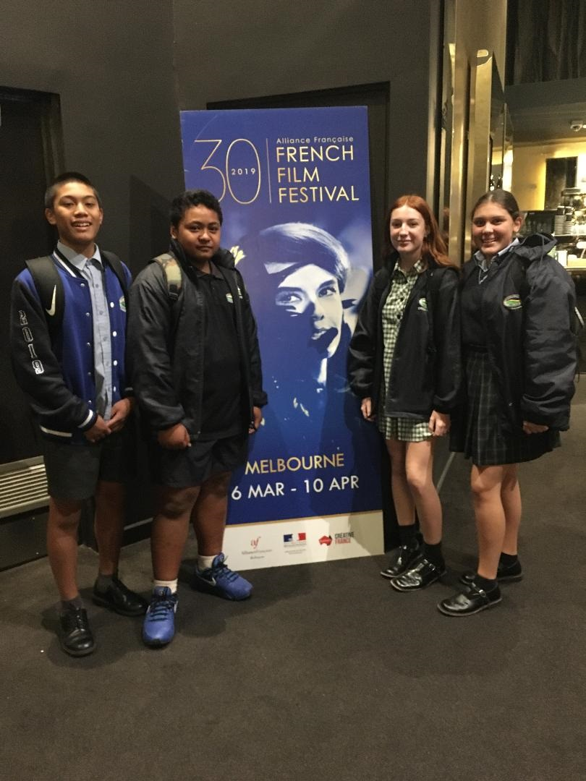
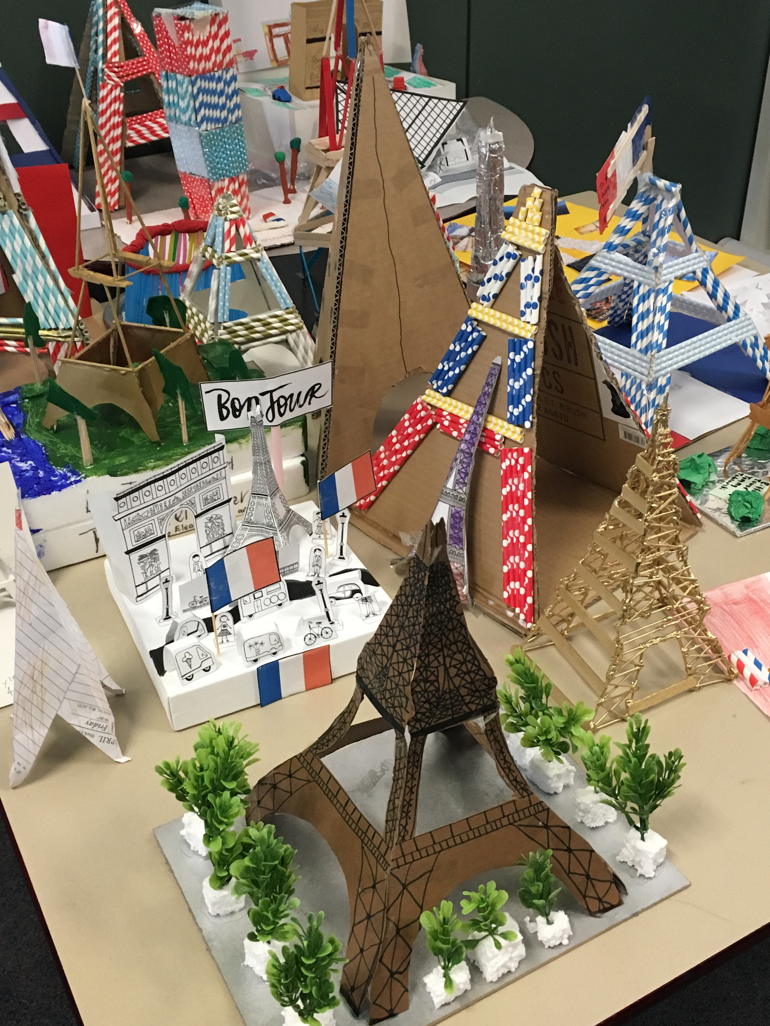
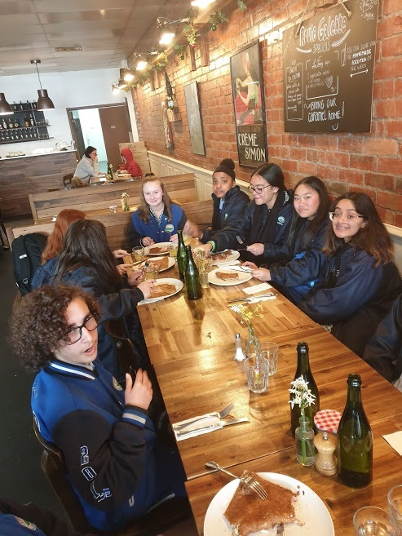
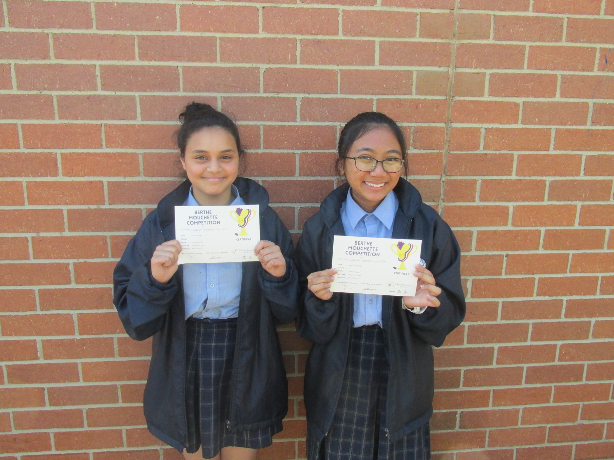
FRENCH
Notes:
Caroline

Slide 30
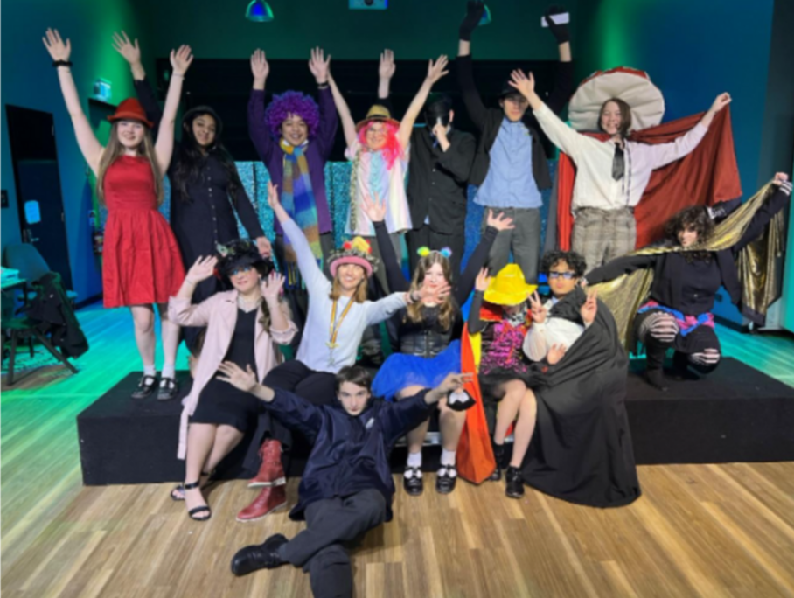
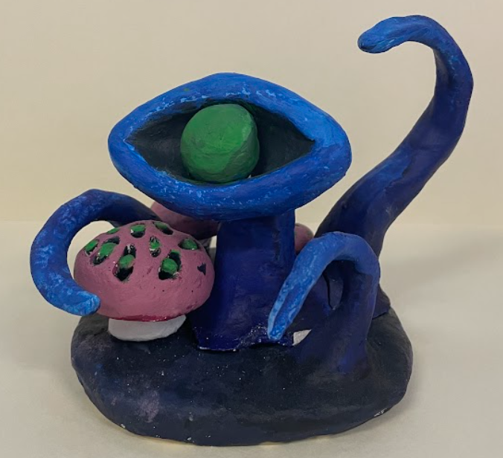
THE ARTS
Year 7
Music/Drama
Visual Art
Visual Communication
Year 8
Music/Drama
Visual Art
Media
Year 9
Music
Dance/Drama
Visual Art
Media
Visual Communication
Notes:
Caroline
Term 1 Mixed Media – looking at science/scientific imagery of microscopic plates as inspiration students using drawing to develop their individual microbes, composition of ‘petri dishes’, they trial and experiment with watercolour paint before refining and finishing a mixed media artwork of a microscopic plate/petri dish (I have examples from this term if you would like some)
Term 2 Lino Printing – Looking at music/songs as inspiration students select a song, pull out visual language to use when developing imagery for a lino print. They use this imagery for a composition which will transferred to a lino block, cut and printed
Literacy focus - art elements and principles and annotation skills
Year 8
Term 1 Sculpture – Students are working under the theme of identity to create clay bust self-portrait. They brainstorm ideas around their own identity, develop symbols and identity markers and plan versions of their bust in the visual diaries before starting to build. Once built and fired they then paint them with acrylic paint.
Term 2 Painting – In term 2 students are given more choice. Still working under the overarching theme of identity they are encouraged to develop their own specific concept while working within the medium of painting. They follow the process of generating an idea, planning and research, trials and experimentation before moving onto creating a final artwork.
Literacy focus – introduce art analysis and research of artists/art movements (term 2), continue to develop annotation skills as reflection/reflexive practice
Year 9
Term 1 – Students move through the art process independently (research/planning – trial and experimentation – refinement of ideas – finished artwork), they generate their own theme/concept and get a choice of any medium. Teacher works more as facilitator and as a support. Greater emphasis on art analysis and research into art movements and artists as inspiration.
Term 2 – Council Project – students work with an outside artist and follow a council brief to create works for public display around CS lake. They will be focus on story telling and the history of the area as inspiration. The works will be stop motion animations and use AR and QR codes for people to scan and view the artworks.

Slide 31
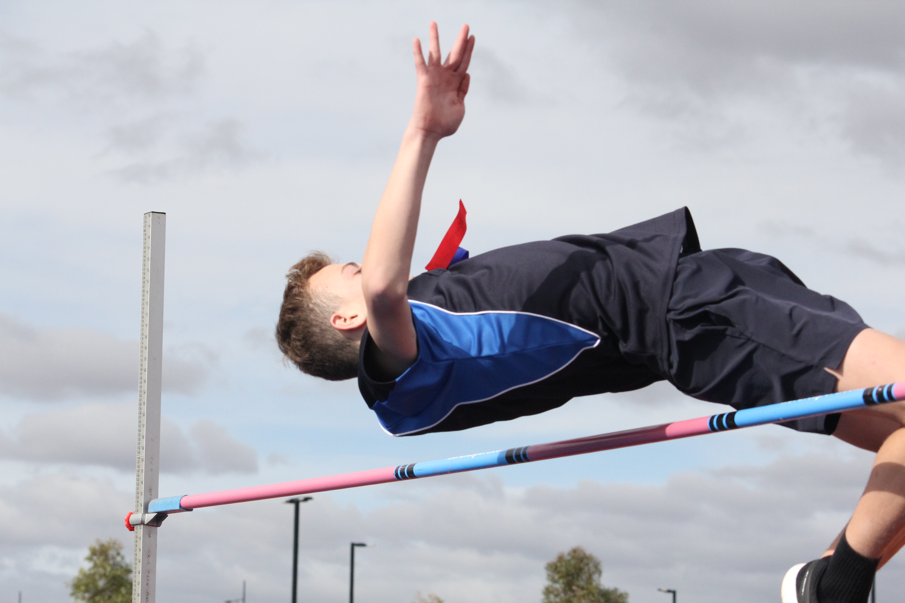
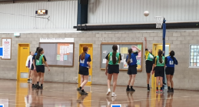
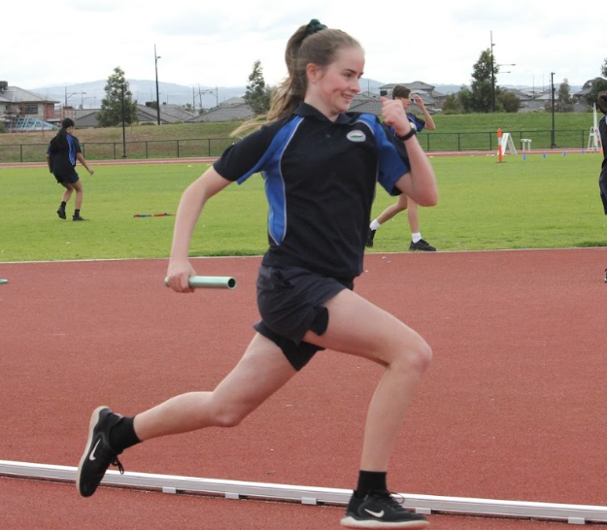
Physical Education & Interschool Sports
Each Week all 7-9 Classes have:
100 mins PE Practical Sessions and Year 9s have 100 mins of theory.
Interschool Sports
basketball soccer netball football | cricket softball table tennis badminton | hockey cross country tennis volleyball
Notes:
Caroline

Slide 32



EXTRACURRICULAR ACTIVITIES
PROGRAMS AND EVENTS BEYOND THE CURRICULUM
The Swimming and Athletics carnivals
Lunchtime clubs (e.g. Book club, Gaming club, Arts and Crafts)
Student leadership
Breakfast club
Instrumental music program
Maths & Science talent quest
Victorian High-Ability Program
Hear from our student leaders!
Notes:
Caroline

Slide 33
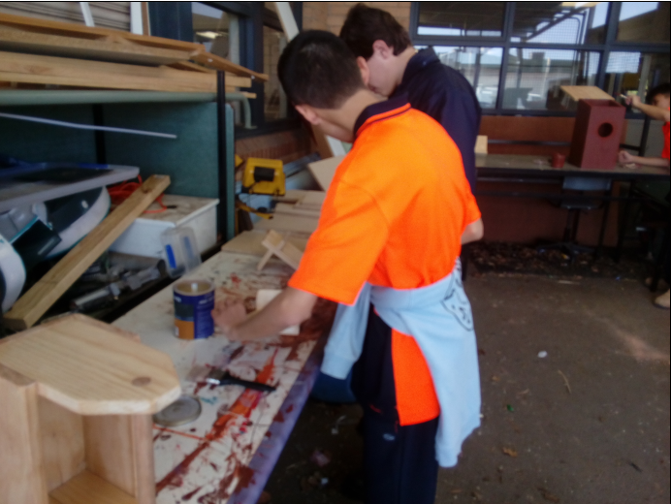
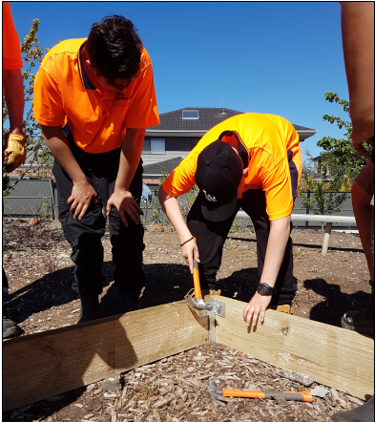
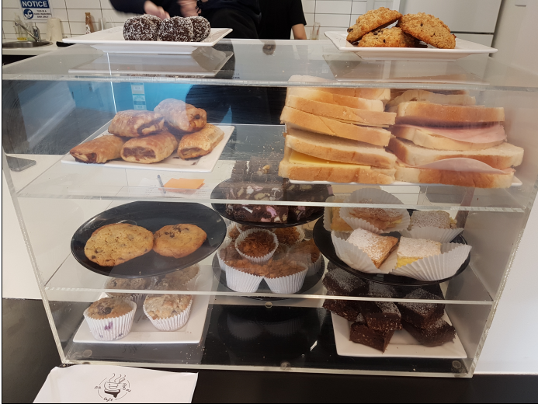
HANDS ON LEARNING
BUILDING & CONSTRUCTION | HOSPITALITY
Learning activities include woodwork, building basic structures, painting, landscaping & school beautification projects. | Students learn safe food handling processes, barista training, food preparation, customer service and basic small business principles while working in the Hideout Café.
Notes:
Caroline

Slide 34
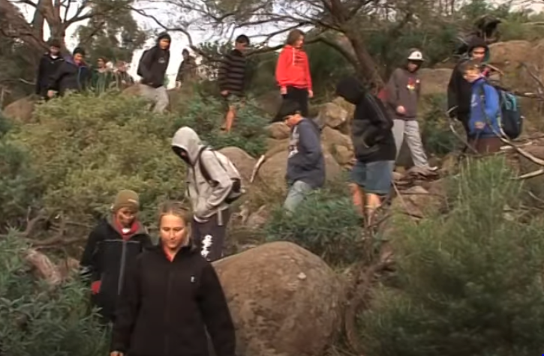
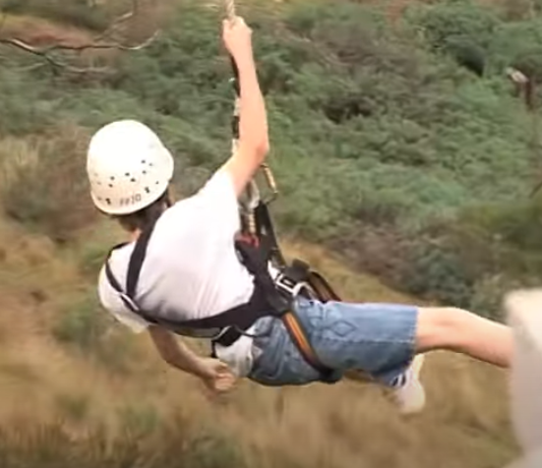
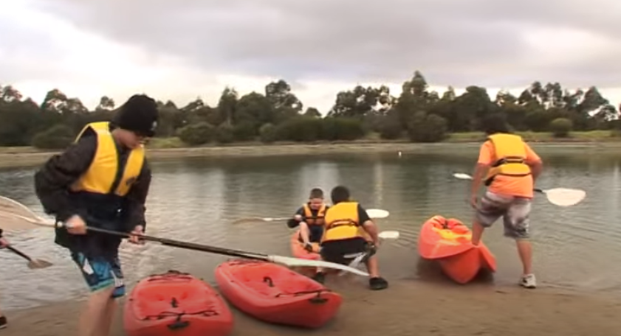
YEAR 7 CAMP
THE AIM OF THE CAMP:
Further build positive relationships with peers and staff
Work in cooperative teams
Explore creative and problem solving capacities
Work, play and have fun in a bush setting
Provide leadership opportunities
Encourage group collaboration
Hear from our student leaders!
Notes:
Caroline

